Slide 1


SINGLE DOOR CHILLER
MODEL : D 372

Slide 2
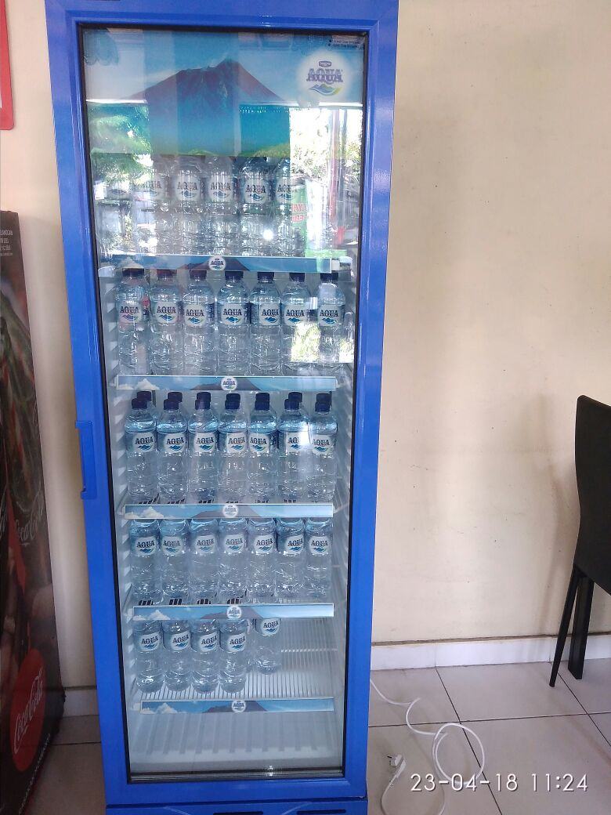
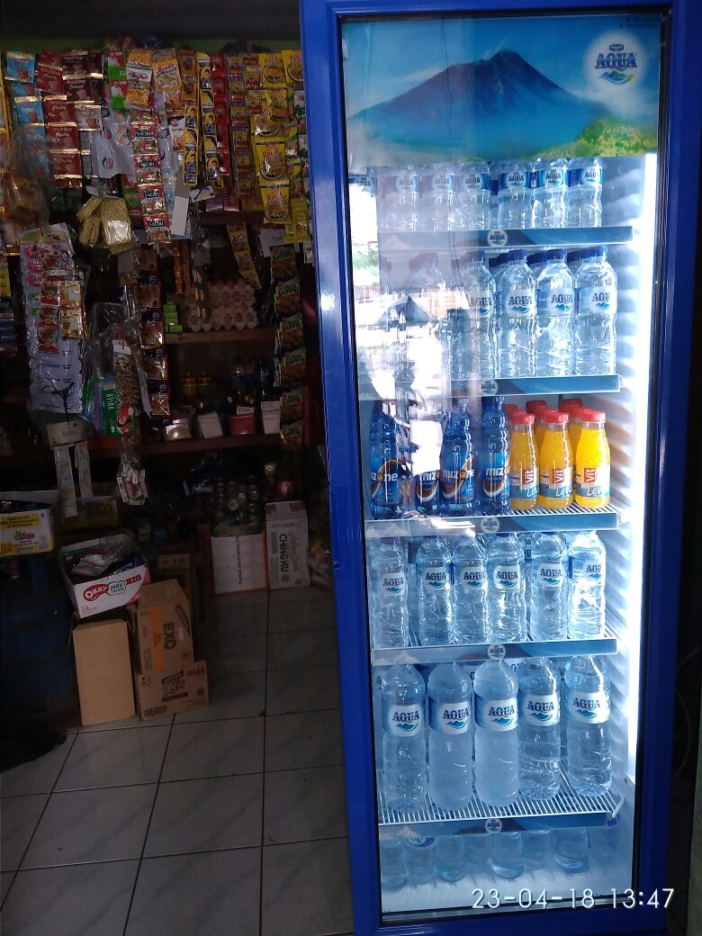
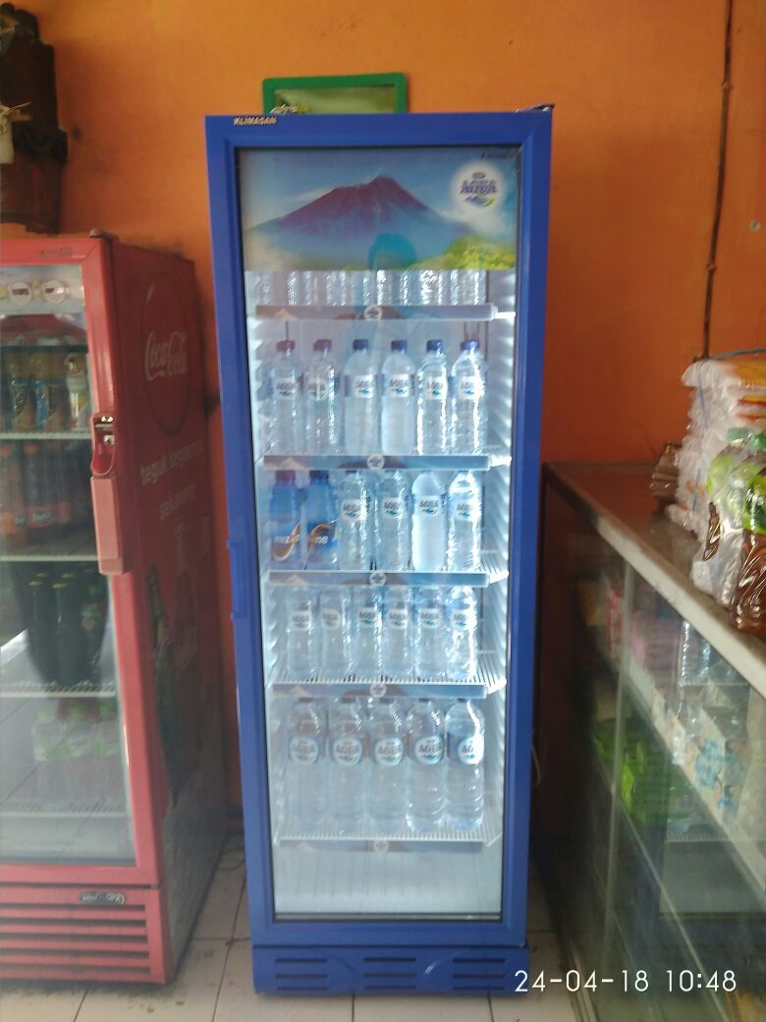
D 372 SC – ON MARKETS

Slide 3
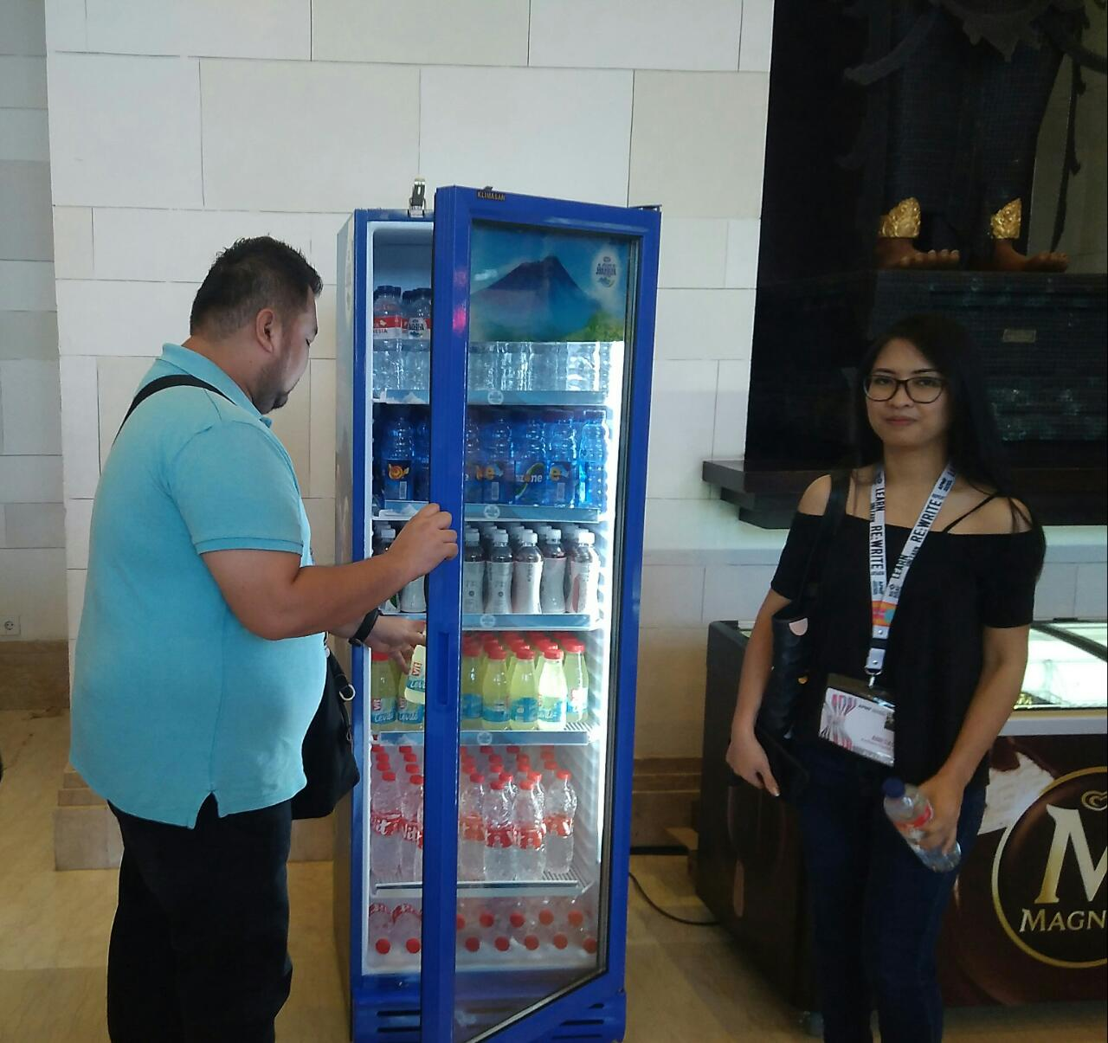
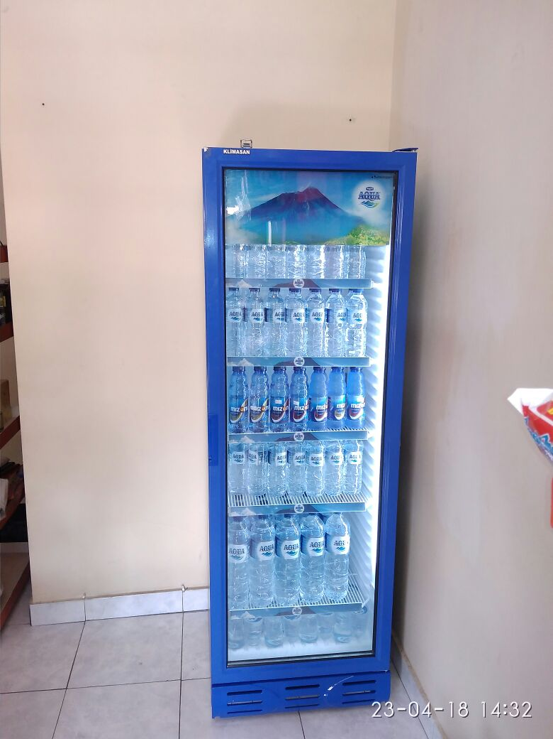
D 372 SC – ON MARKETS

Slide 4
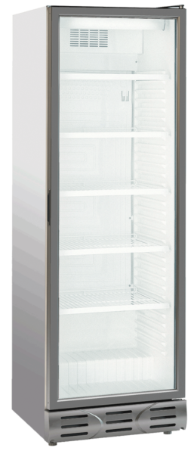
METALFRIO CHILLER – MODEL D 372
TECHNICAL SPESIFICATION |  |  | Units | D 372 WOC
CAPACITY |  |  | Lt | 382
DIMENSION (WxDxH) |  |  | mm | 595 x 624 x 1803
WEIGHT |  |  | kg | 69
TEMP RANGE |  |  | °C | 0 / 10 °C
REFRIGERANT |  |  |  | R600a (HC)
FACING |  |  |  | 7
CAN 330ML LOADING |  |  | cans | 420
BOTTLES 500ML LOADING |  |  | bottles | 210
QTY SHELVES |  |  | Set | 5
POWER - COMPRESSOR ON |  |  | WATT | 220
POWER - COMPRESSOR OFF |  |  | WATT | 50
ENERGY CONSUMPTION |  |  | kWh/24h | 3,53
ELECTRICITY COST / DAY |  |  | IDR | Rp. 4,589,-

Slide 5
METALFRIO CHILLER – MODEL D 372
LOADING PRODUCT CAPACITY |  |  |  | D 372
1ST SHELF (BOTTOM) |  |  | CAN 330ml | 84 CANS (7X6X2)
2nd SHELF |  |  |  | 84 CANS (7X6X2)
3rd SHELF |  |  |  | 84 CANS (7X6X2)
4th SHELF |  |  |  | 84 CANS (7X6X2)
5th SHELF (TOP) |  |  |  | 84 CANS (7X4X2)
TOTAL |  |  |  | 420 CANS
1ST SHELF (BOTTOM) |  |  | PET 500ml | 42 BOTTLES (7X6)
2nd SHELF |  |  |  | 42 BOTTLES (7X6)
3rd SHELF |  |  |  | 42 BOTTLES (7X6)
4th SHELF |  |  |  | 42 BOTTLES (7X6)
5th SHELF (Top) |  |  |  | 42 BOTTLES (7X6)
TOTAL |  |  |  | 210 BOTTLES

Slide 6
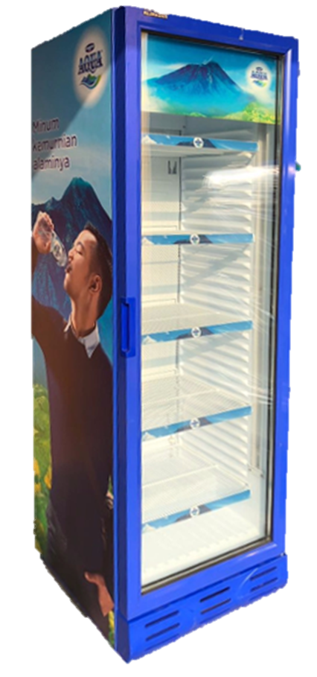
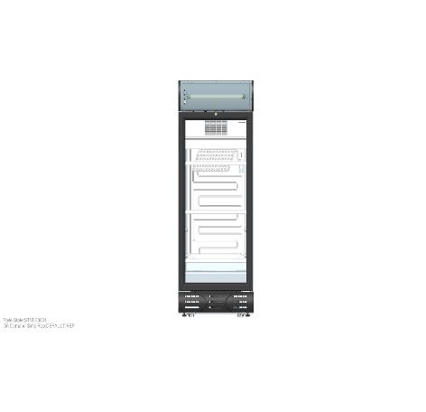
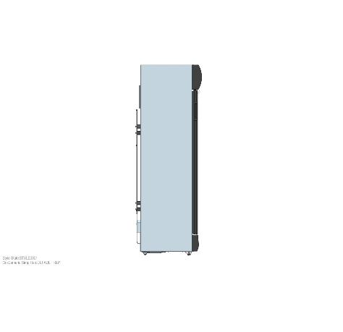
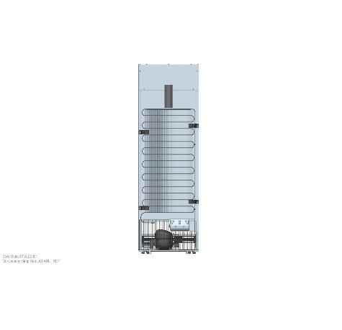
D 372 – Main Benefit
TRIPLE GLASS
Double Tempered
Low E in the middle
LOW ENERGY CONSUMPTION
3.5 KWH/24hrs
EASY RE-MERCHANDISING
No clips / No pilaster shelving system
ENHANCED PRODUCT VISIBILITY
Maximum facings
Small metallic bottom air-frame
FREE MAINTENANCE
Wire Tube Condenser

Slide 7
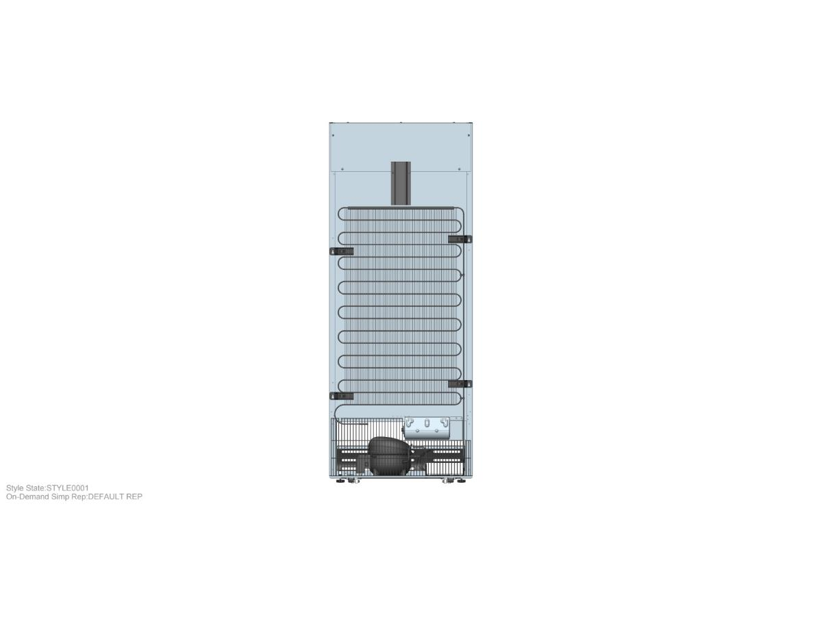
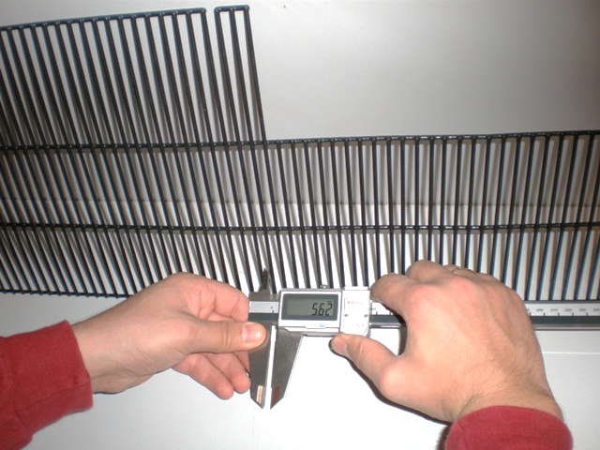
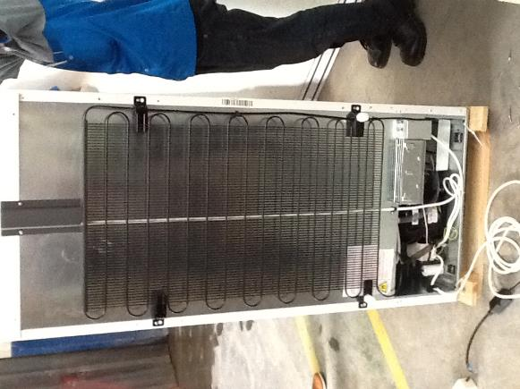
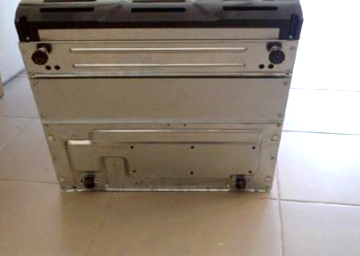
D 372 SC M4C – Wire Tube Condenser

Slide 8
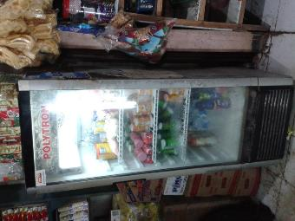
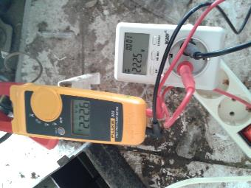
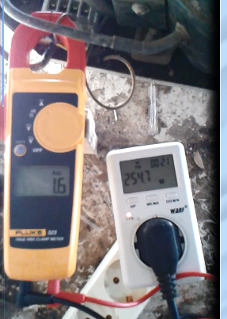
COMPARISON – GENERIC WHITE 200LT
VOLUME : 180LT | AMPERE | VOLTAGE

Slide 9
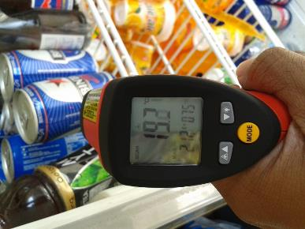
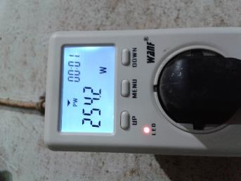
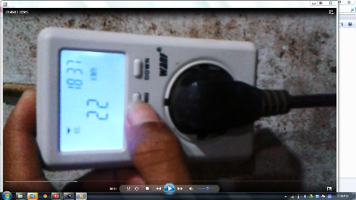
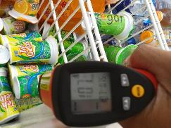
COMPARISON – GENERIC WHITE 200LT
PRODUCT TEMP | WATTAGE | ELECTRICITY CONSUMPTION / WEEK

Slide 10
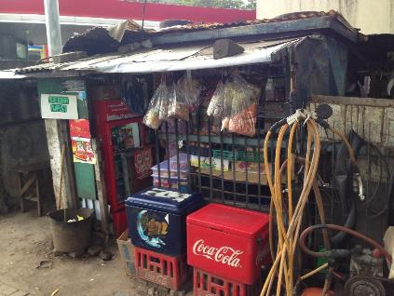
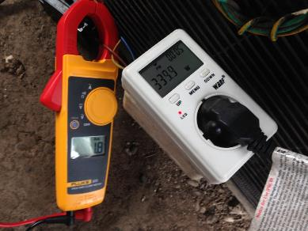
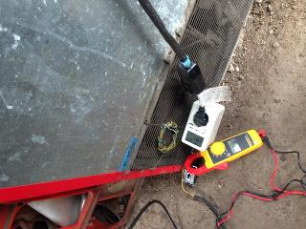
COMPARISON – RED COOLER
VOLUME : 300LT | AMPERE | WATTAGE

Slide 11
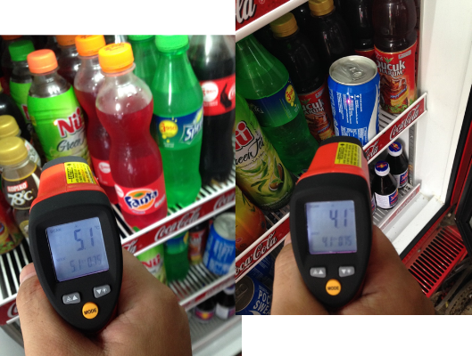
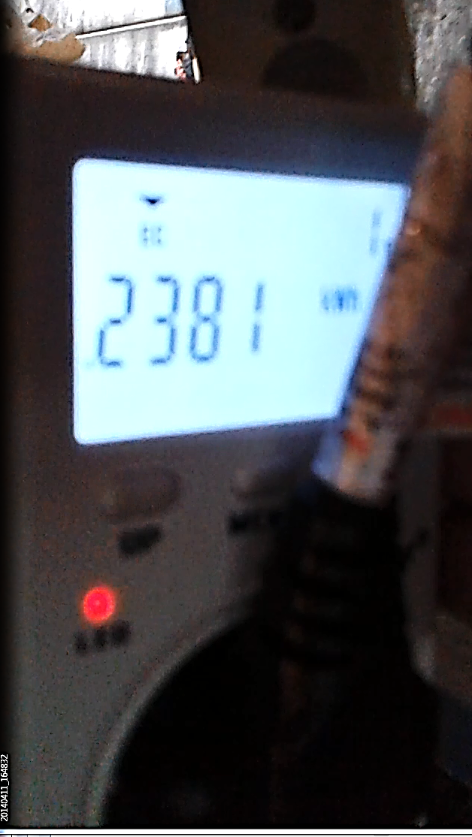
COMPARISON – RED COOLER
PRODUCT TEMP | ELECTRICITY CONSUMPTION / WEEK

Slide 12
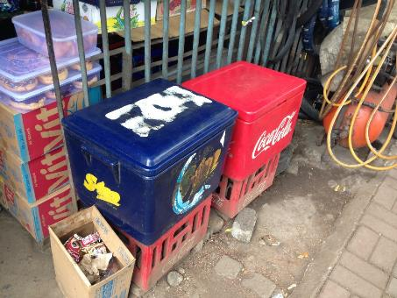
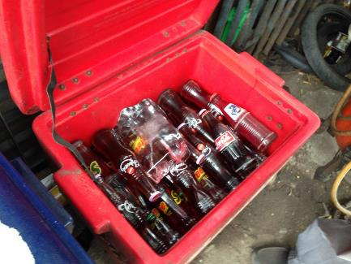
COMPARISON – ICE CHEST

Slide 13
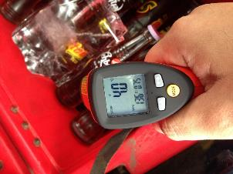
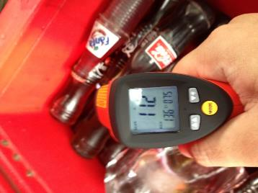
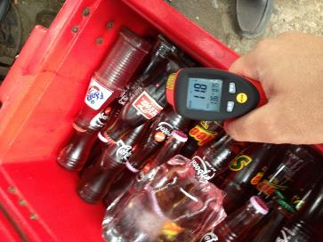
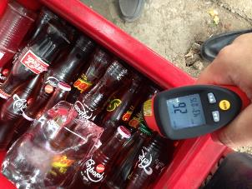
COMPARISON – ICE CHEST
THE COOLING PROCESS CANNOT BE DONE EVENLY USING ICE ON BOX

